Slide 1
Analysing growth rates in a lemon orchard using profile analysis
Supervisor: Dr Johan Hugo
Co-Supervisor: Mr Lulama Kepe

Slide 2
introduction
Citrus fruit is the largest fruit industry in South Africa, in terms of production volume, with lemons constituting 15% of all total production.
Approximately 76% of all southern Africa’s citrus is exported as fresh fruit. These exports generate 92% of the total income achieved by the region’s citrus growers.
For citrus production to be profitable, the orchard must produce high yields of quality fruit every year, and do this consistently over a long period of time since countries that citrus fruit are exported to every year come and inspect the growers for certification
The challenge is therefore to make production decisions and take actions to ensure high annual production of marketable fruit, while ensuring that these decisions and actions contribute to the long-term sustainability of the orchard.

Slide 3
Problem statement
Citrus originated from the subtropical regions of southeast Asia. In the wild, citrus trees in these regions produce fruit all year round, and the fruit are small, poorly coloured and blemished. In the absence of effective production practices, citrus trees don’t produce fruit suitable for market.
Citrus production is largely concerned with management practices and processes that manipulate the tree to produce high yields of marketable fruit
Even with these management practices and processes, lemon trees still take 4 years to grow and start bearing fruit and although trees in an orchard are often clones of each other, they do not grow the same
Since the trees receive the same amount of water and nutrients a possible cause of this could be competition between the trees

Slide 4
objectives
Analyse growth rates of trees
Build profiles of tree growth
Use profile analysis to see if growth rates are similar on different sections of a plot which in this case represents a specific orchard

Slide 5
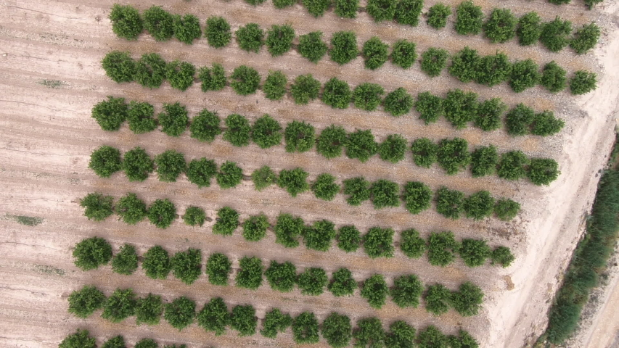
data
The data was collected from a lemon orchard in Kirkwood
In order to estimate the growth rates, the following were measured: tree height, crown diameter and diameter at basal height (dbh)
These measurements were taken at 5 different periods
The size of the plot is 15x15 but trees that were on the perimeter of the plot were disregarded as they do not have a tree to compete with on all sides leaving us with a 13x13 plot to work with
13
13

Slide 6
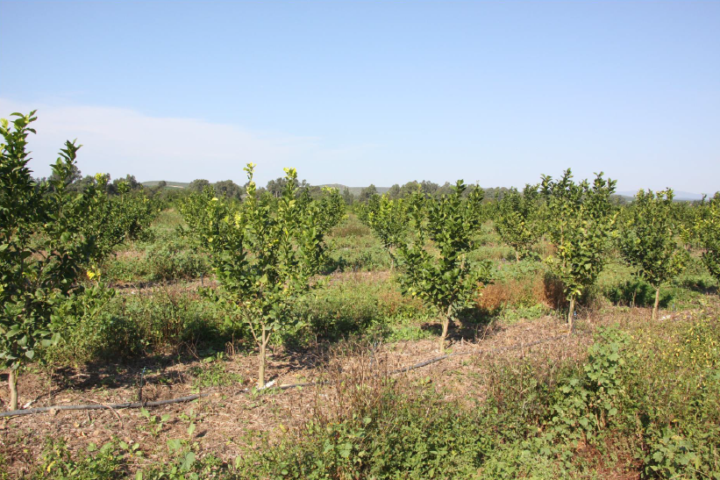
Diameter at basal height

Slide 7
Profile Analysis
To analyse whether or not the growth rates were similar across the plot, profile analysis was used
Profile analysis is most commonly when either comparing the same dependent variables between groups over several time-points or when there are several measures of the same dependent variable
In this project we were dealing with the first case as we wanted to compare the diameter at basal height in different sections of the plot over several time-points
The main thing we wanted to see was if the profiles would be parallel or not as this would give information about the uniformity of the growth rates across the plot

Slide 8
Experimental Setup & Data Sorting
In order to perform the analysis on the data, the profieR package was downloaded and installed in R
The pbg (profile by group) function was used to test whether the profiles were parallel, equal and level across two groups and also to plot the profiles
The function accepts the following arguments: pbg(x, y, original.names = TRUE, profile.plot = TRUE, …)
The function then returns a summary of the means of the observed variables, the results of the F-tests and a profile plot of the groups

Slide 9
Experimental setup & Data sorting
In order to create the profiles needed, 5 13x13 matrices containing the diameter at basal height of the trees were created in R. One for each time period
The matrices were then divided into 4 different submatrices: Q1, Q2, Q3 and Q4, each of them representing a different quadrant of the orchard.
Q1
Q2
Q3
Q4

Slide 10
Experimental Setup & Data Sorting
The Q_{i} contains all the height measurements of the quadrant at the different time periods for i = 1, 2, 3, 4.
The profiles were built over 5 time periods for each quadrant and 6 pairwise profile comparisons were done namely between Q1 and Q2, Q1 and Q3, Q1 and Q4, Q2 and Q3, Q2 and Q4 and between Q3 and Q4
Each of the 6 pairs were put into the pbg function and the following results were obtained…

Slide 11
Results
The following results were obtained by testing the hypothesis H₀: The profiles are parallel H_{a}: The Profiles aren’t parallel
α = 0.05
For each of the 6 pairs
 | P-value
Q1 and Q2 | 0.03206561
Q1 and Q3 | 0.001807192
Q1 and Q4 | 0.0003167727
Q2 and Q3 | 8.663102e-09
Q2 and Q4 | 4.853999e-08
Q3 and Q4 | 0.09470247

Slide 12
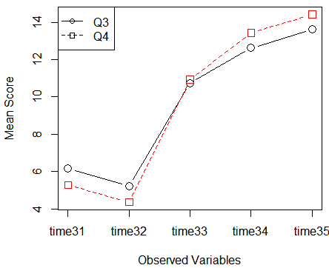
Results
Looking at Q3 and Q4, which was the only pair to have a p-value that led to not rejecting the null hypothesis
We can see that the plots are almost perfectly parallel. The only cause for concern might be why the growth rate seems stagnant from period 1 to 2

Slide 13
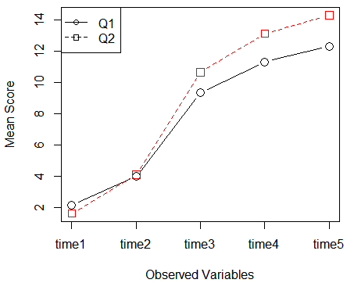
Results
Looking at Q1 and Q2, even though statistically there is a significant p-value indicating that the line segments aren’t parallel, practically, for the farmer, looking at the profile plot the deviation from parallelism is negligible.

Slide 14
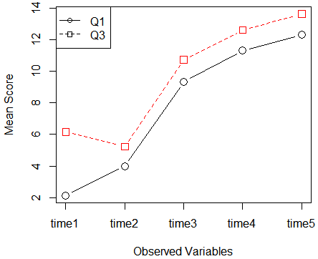
Results
Looking at Q1 and Q3 it can be seen that the p-value is significant and the first line segment (from period 1 to 2), contributes the most to the rejection of the null hypothesis. This is important for the farmer since some intervention strategy might be necessary during the initial phases to ensure consistent growth rates
The trees are clones but the initial growth rate isn’t the same. Trees that were planted in December are supposed to be the same size but 5 months later their growth is not at the same level which means that initially their growth rate was not the same.

Slide 15
Conclusion
Growth rates produced parallel profiles across the plot from the 2nd to the 5th period
Allen-Coomes(2007) argued that trees compete the most among each other when they are the smallest which can be seen when looking at the profile plots between time period 1 and 2.
The initial growth rates also showed a difference between the top and bottom half of the orchard which should be investigated

Slide 16
Future research
We’ve checked if the growth rates are similar on different sections of a lemon orchard over the tree growth periods.
This can be used to indicate similar soil, nutrient and water content. If there is no difference in growth rates, it indicates uniformity in the tree growth and resources provided
For future research, if the average growth is uniform across the plot, then individual tree growth models can be developed to determine competition indices between individual trees with specific reference to the citrus industry

Slide 17
references
Hattingh V. (2018) South African farmers play major role in global citrus industry. Available at: https://www.google.com/amp/s/lowvelder.co.za/445158/south-African-farmers-play-a-major-role-in-global-citrus-industry/amp (Accessed: 12 July 2019)
Coomes, D & Robert, A (2007). Effects of size, competition and altitude on tree growth, Journal of Ecology 95, pp. 1084-1097
Zekuri, M. (2011). Factors affecting citrus production and quality. Citrus Industry
Bulut, O & Desjardins CD . Profile Analysis of Multivariate Data in R: An introduction to the profileR Package, Journal of Statistical Software, pp. 1-29

Slide 18
references
Morton, J (1987). Lemon, Fruits of Warm Climates, pp. 160-168
Coomes, D & Robert, A (2007). Effects of size, competition and altitude on tree growth, Journal of Ecology 95, pp. 1084-1097
Genard M, Lescourret F, Moitrier N,Valsesia, P (2010). QualiTree, a virtual fruit tree to study the management of fruit quality
McPherson EG, Peper PJ (2012). Urban Tree Growth Modelling, Arboriculture & Urban Forrestry 38(5), pp172-180

Slide 19
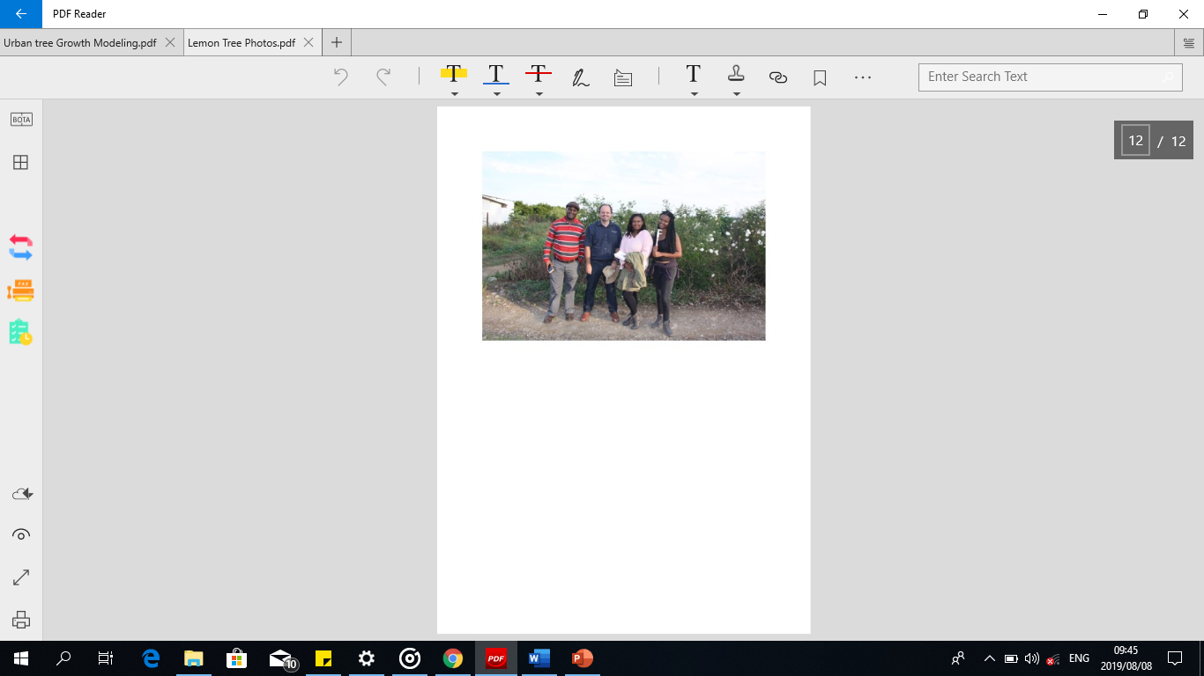
Thank you

